Slide 1
Pricing Strategy of Skiing Ticket for Big Mountain Resort
Yang Li - December 6th, 2020

Slide 2
Problem Identification
What is the possibility for Big Mountain Resort to increase net revenue by at least 15% in the next season through adjusting the value of ticket prices, capitalizing facilities, and cutting operation costs.
Scope | Pricing; Changes of facilities; Cutting Operating Costs.
Constrains | Higher ticket prices could drive customers away No data for number of visitors for other resorts No data for operating costs for other facilities

Slide 3
Problem Identification
What is the possibility for Big Mountain Resort to increase net revenue by at least 15% in the next season through adjusting the value of ticket prices, capitalizing facilities, and cutting operation costs.
Stakeholders | Jimmy Blackburn, Director of Operations Alesha Eisen, Database Manager
Key data sources | A CSV file from the database manager that contains most of the ski resorts in U.S.

Slide 4
Recommendation and Key Findings
Assuming 350,000 visitors and each visitor bought a 5-day pass, the current features can support a higher price ($94.22) compared to the actual price ($81.00), leading to a 16.32% net revenue increase.
Adding one run, adding one chair lift, and increasing vertical drop by 150 feet can support an increase of ticket price by $1.99 (the price is $96.21), leading to a 17.69% net revenue increase.
Cutting operating cost by closing least used runs would be beneficial. However, the cost of each run is needed.
Adding snow making areas or increasing longest run doesn’t seem helpful.

Slide 5
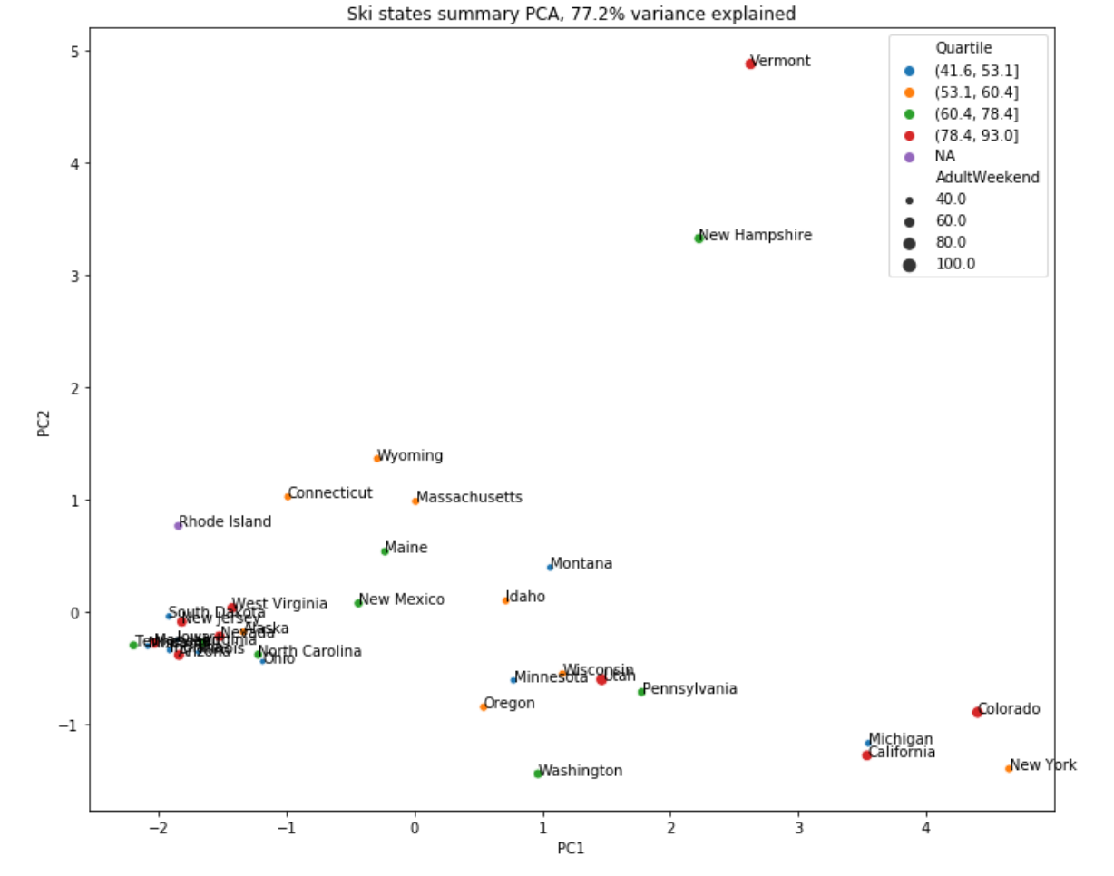
Data Description
U.S. Ski Resort data set
Combined with state population and size information
Weekend price is the target of prediction
PCA indicates that states have no obvious correlation with prices, therefore, treat states equally
A random forest regression model is selected, and evaluated by a cross-validation technique
PCA summary plot of the ski resort ticket prices grouped by states. It indicates an irrelevant feature between states and ski resort prices.

Slide 6
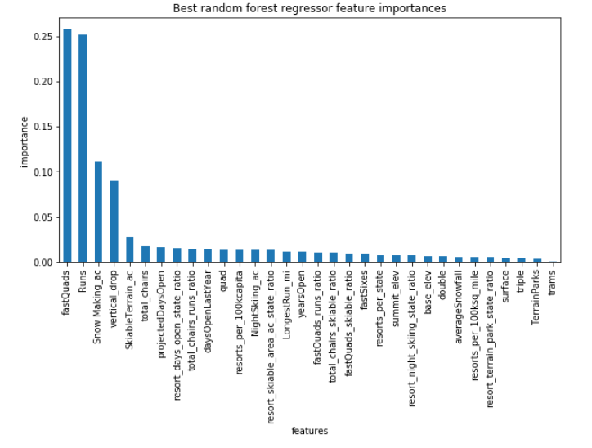
The Random Forest Model & Importances of Features
Model performance: price’s mean absolute error in average from cross validation on 30% test data is $9.66, STD in average is $1.35.
Without any feature change, the predicted price for Big Mountain Resort is $94.22±10.39.
Some features have significant impacts on prices.
Feature importances from the random forest regression model.

Slide 7
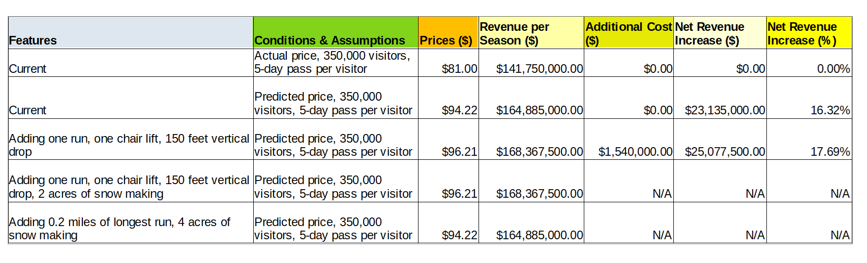
Summary of Predicted Prices

Slide 8
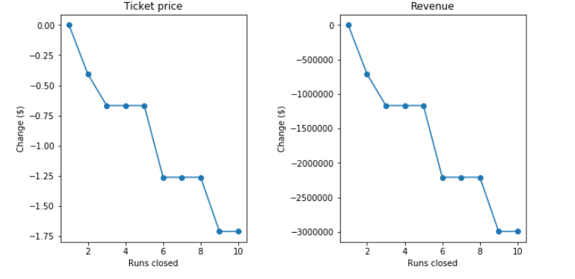
An Alternative Approach: Closing Runs
Closing runs would cut cost, and also decrease prices.
The price decreasing rate varies.
If we know cost of each run information, an optimized point can be found about how many runs should be closed.
The changes of predicted price and revenue against how many runs closed.

Slide 9
Summary and Conclusion
A random forest regression model was used on the U.S. ski resort data.
The current features can support a higher price ($94.22) compared to the actual price ($81.00), leading to a 16.32% net revenue increase.
A change of features such as adding one run, one chair lift, and 150 feet vertical drop can support a price of $96.21, leading to a 17.69% net revenue increase.
Cutting operating cost by closing least used runs would be beneficial. However, the information about the cost of each run is needed.
Adding snow making area or longest run doesn’t seem to be helpful.
The current model can be considered for use on continuous basis. Improvement can be made with more features and data.

